Slide 1

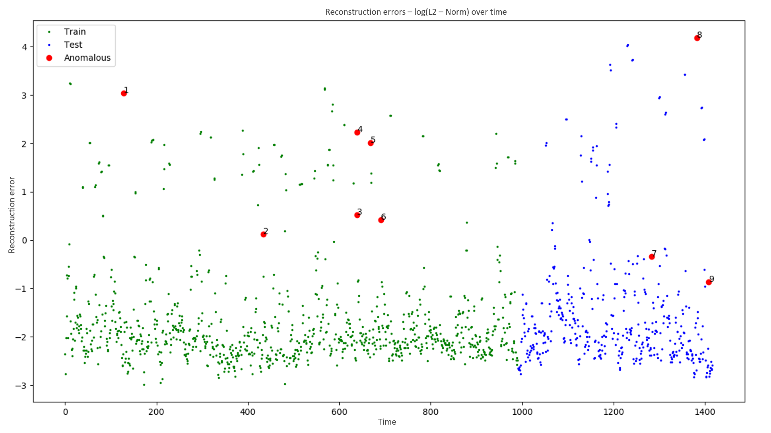
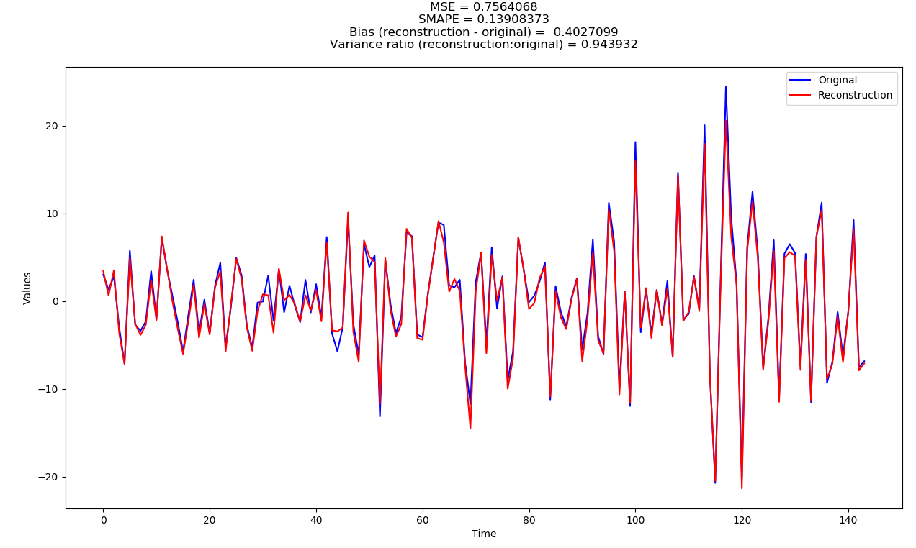
Anomaly detection and generation in time-series for predictive asset maintenance Final presentation 10th September 2019
Hitesh Kumar
Department of Earth Science and Engineering - Imperial College London
Data Science - Shell Research Limited

Slide 2
Overview
Background on the problem
Data and EDA
Anomaly detection
Anomaly generation
Question time

Slide 3
Background

Slide 4
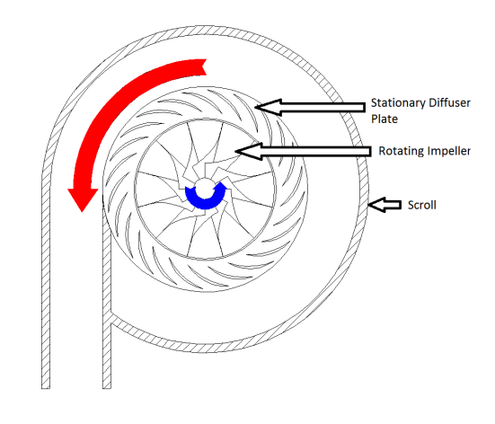
Some context first…
Compressors play a big part in natural gas extraction and processing.

Slide 5
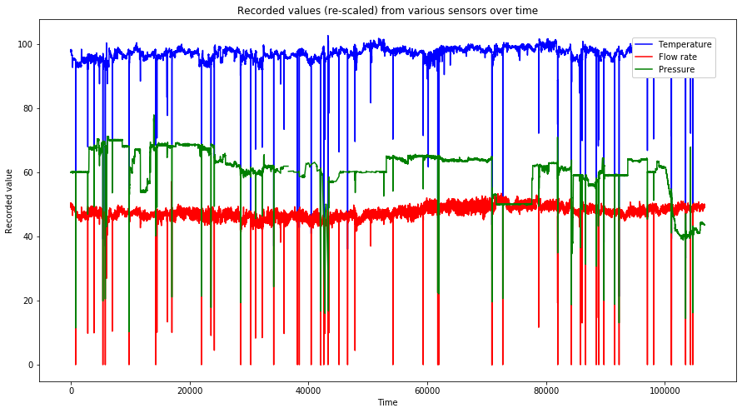
Some context first…
Input/output pressures, temperatures, flow rates and other variables change a lot during operation

Slide 6
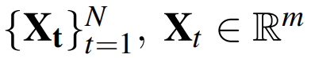
Some context first…
Input/output pressures, temperatures, flow rates and other variables change a lot during operation
So we have a m-dimensional multivariate time-series of length N

Slide 7
Some context first…
But sometimes they behave badly, causing:
Efficiency reduction
Automated/manual shutdowns
Damage to parts
Financial losses (for everyone) + Health and safety risks

Slide 8
Some context first…
So now we had our task; Multivariate time-series anomaly detection!
We split this into 3 sub-tasks
Find a way to detect anomalous intervals of time in our data-set
Predict the time until next anomalous event
Determine which features specifically are behaving anomalously/normally in said interval

Slide 9
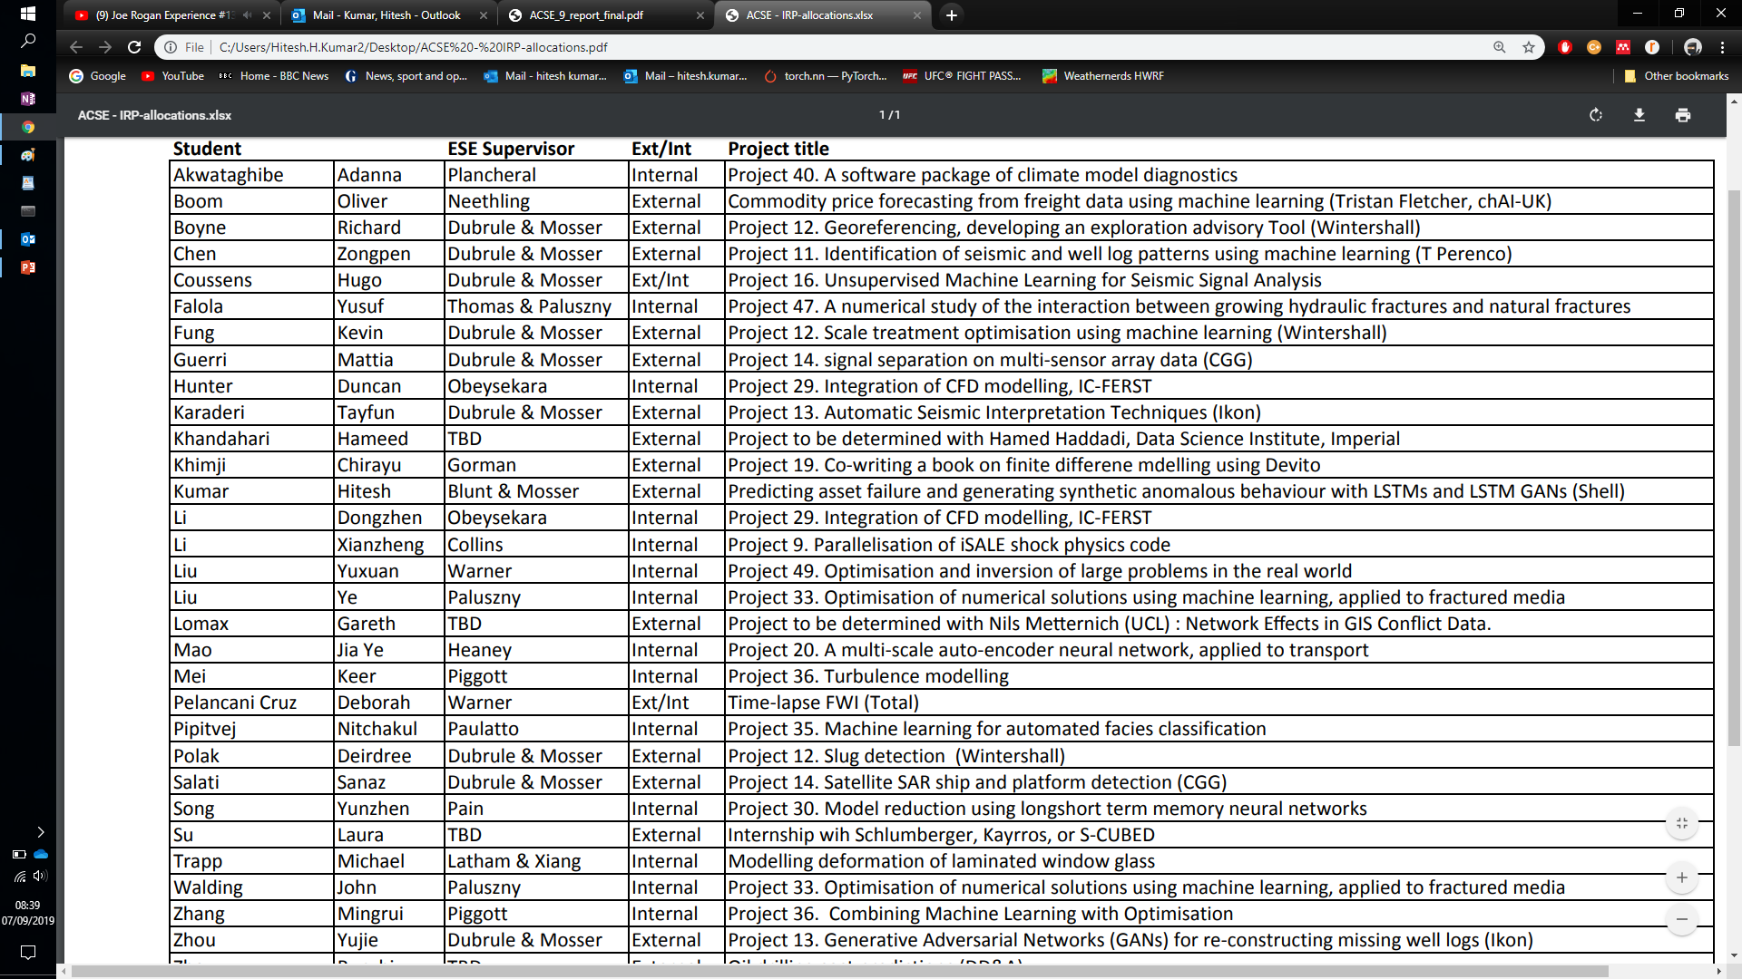
Data and EDA

Slide 10
Our data-set
N = ~130,000 at 10 minute intervals (~2.5 years of data!)
M = 405, but only 227 from the actual compressor

Slide 11
Our data-set
Lets look at time first:
Sometimes the compressor is offline

Slide 12
Our data-set

Slide 13
Our data-set
Lets look at time first:
Sometimes the compressor is offline
This is not “normal” behavior”
Get rid of it

Slide 14
Our data-set
N = ~130,000 ~106,000
M = 405, but only 227 from the actual compressor

Slide 15
Our data-set
Also, we observe the scale of the data changing really strangely at times…

Slide 16
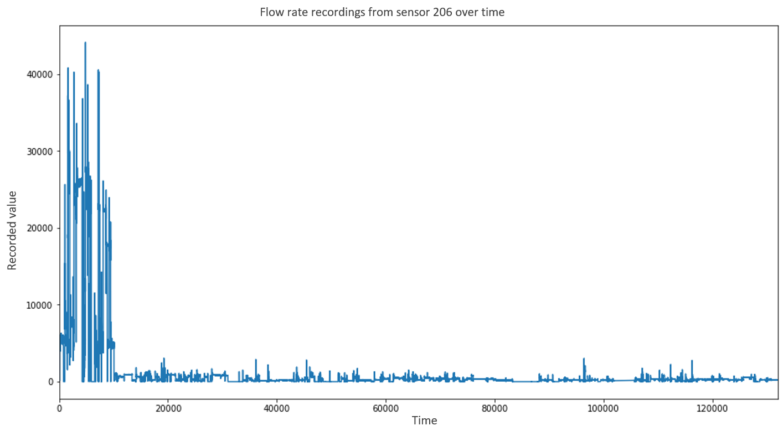
Our data-set

Slide 17
Our data-set
Lets look at time first:
Also, we observe the scale of the data changing really strangely at times…
We have no idea what units it was changed to and from
We tried rolling window normalization, squashing (sigmoid, tanh etc.) and other stuff

Slide 18
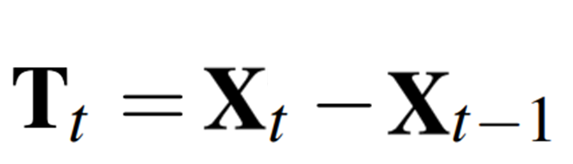
Our data-set
So we decided to instead take the differences between time-steps:

Slide 19
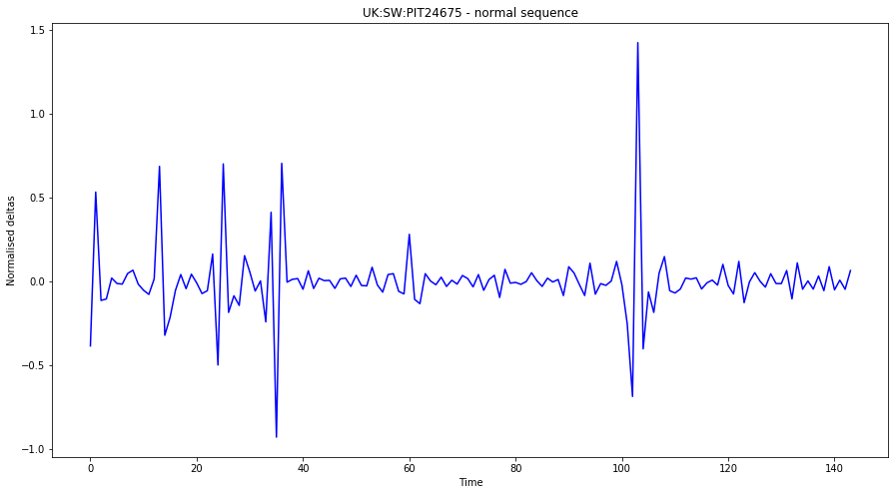
Our data-set
Now the data looks like this

Slide 20
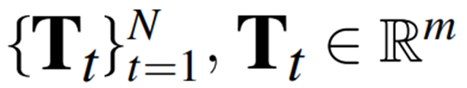
Our data-set
N = ~130,000 ~106,000 ~105,999
M = 405, but only 227 from the actual compressor

Slide 21
Our data-set
And now in space:
There are some features which are just bad…

Slide 22
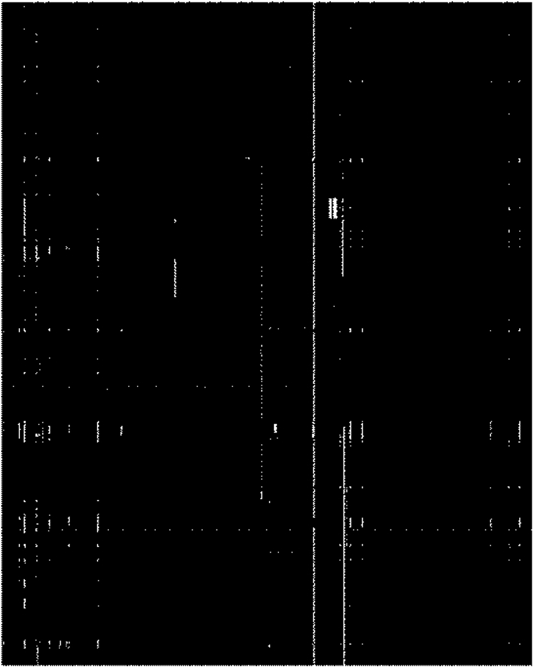
Our data-set

Slide 23
Our data-set
And now in space:
There are some features which are just bad…
So we came up with some criteria, get rid of any feature that:
Has too many missing values overall
Has too many consecutive missing values
Has too low a variance (under review)
Has Less than 2000 unique values
Has too many consecutive 0’s (no change) (second part only)

Slide 24
Our data-set
N = ~130,000 ~106,000 ~105,999
M = 227 112 (subject to decrease)
And finally we standardise this

Slide 25
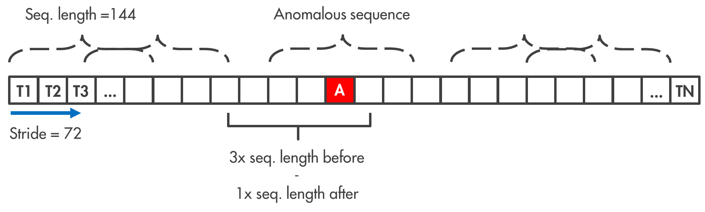
Our data-set
We need to create finite length sub-sequences out of this data

Slide 26
Our data-set
Now we have ~1400 sequences of 144 time-steps each
Each consecutive sequence is 50% the same (maximum) due to a 72-timestep stride
No overlap in training/validation/test sets
9 anomalies at 144 timesteps each, focal point at center in time
PyTorch DataLoader!

Slide 27
Anomaly detection

Slide 28
Considerations
But now we have two issues:
There isn’t any easy way to measure how anomalous time-series are

Slide 29
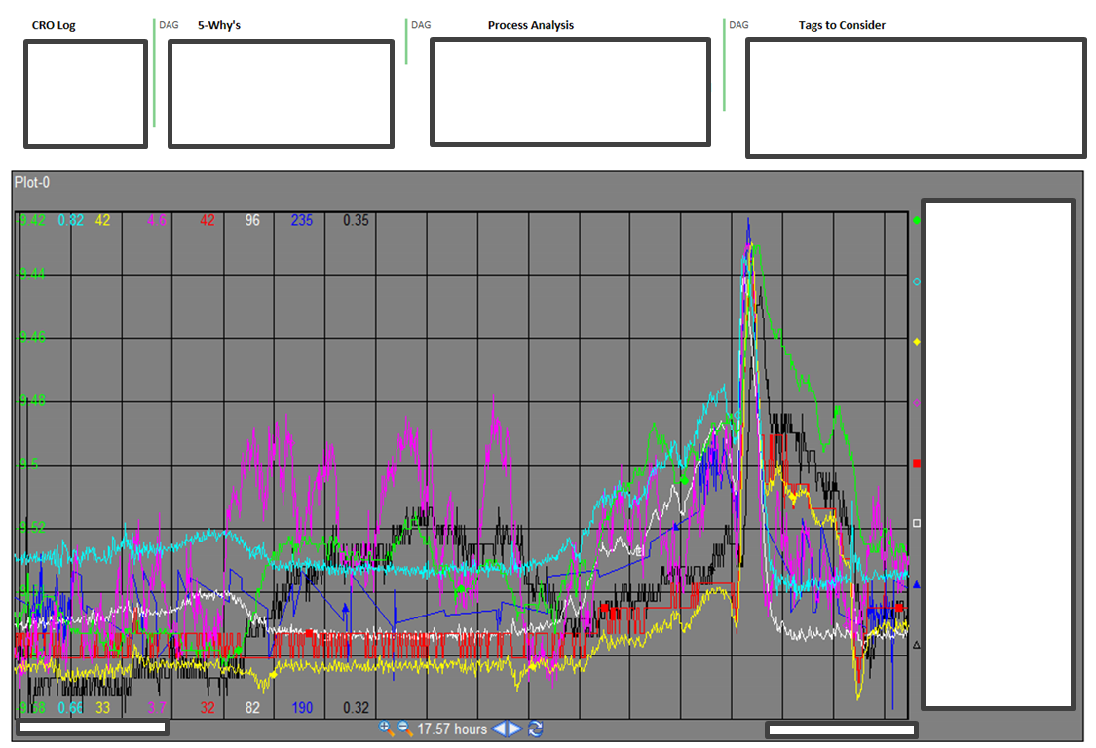
Considerations

Slide 30
Considerations
But now we have two issues:
There isn’t any easy way to measure how anomalous time-series are
There are very few labelled anomalies in the data set

Slide 31
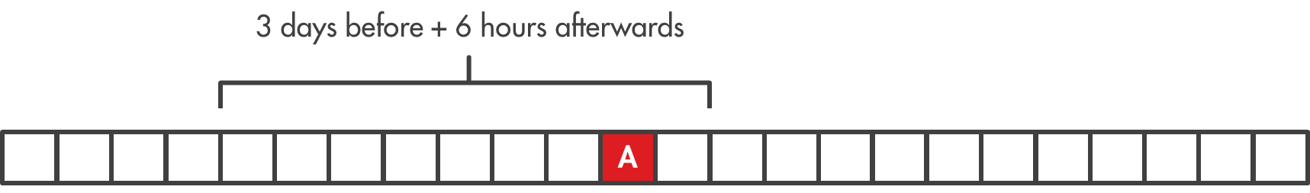
Considerations
We only have 9 labelled anomalies: 9 points in time out of 130,000!
Even by expanding the windows to multiple days around each anomaly, we can only get 4428 points in total.
3%!

Slide 32
Considerations
But now we have two issues solutions:
There isn’t any easy way to measure how anomalous time-series are – Deep Learning
There are very few labelled anomalies in the data set – Unsupervised
LSTM Auto-encoders!

Slide 33
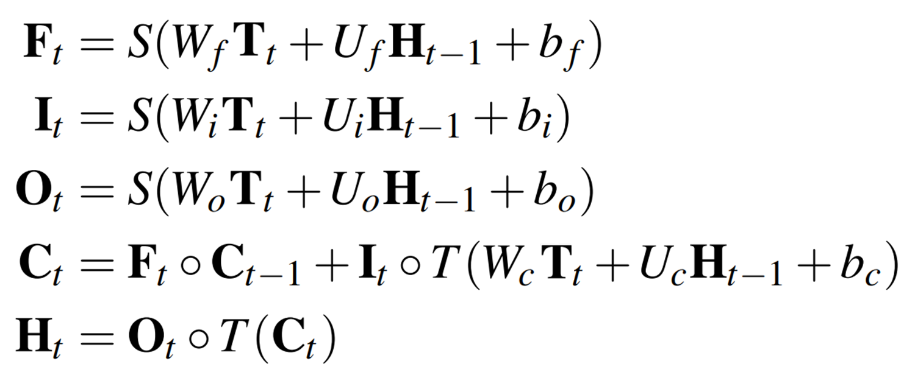
Model and results
LSTM:

Slide 34
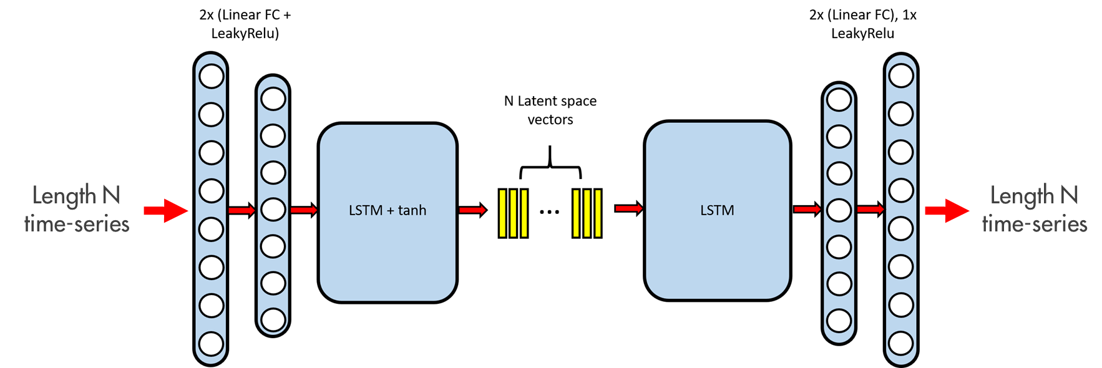
Model and results

Slide 35
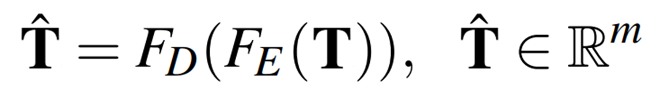
Model and results
Mathematically:
Latent vectors

Slide 36
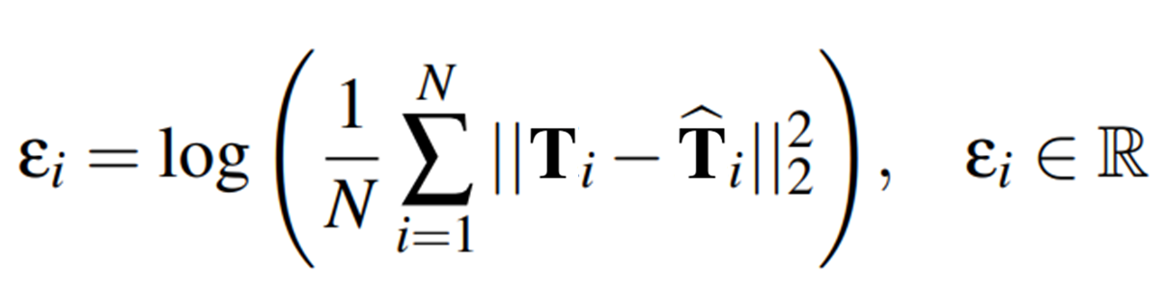
Model and results
Reconstruction error:

Slide 37
Model and results
So there are two things everyone expects from Auto-encoders:
Encoded latent vector projections – Encoding + PCA/TSNE

Slide 38
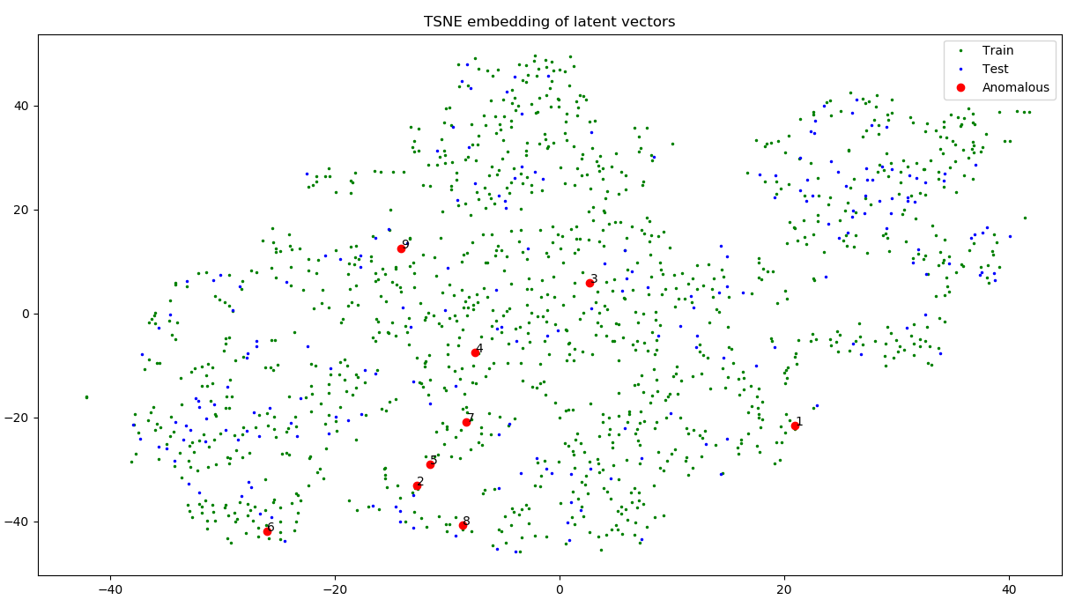
Model and results

Slide 39
Model and results
So there are two things everyone expects from Auto-encoders:
Encoded latent vector projections – Not so good
Reconstruction errors

Slide 40
Model and results

Slide 41
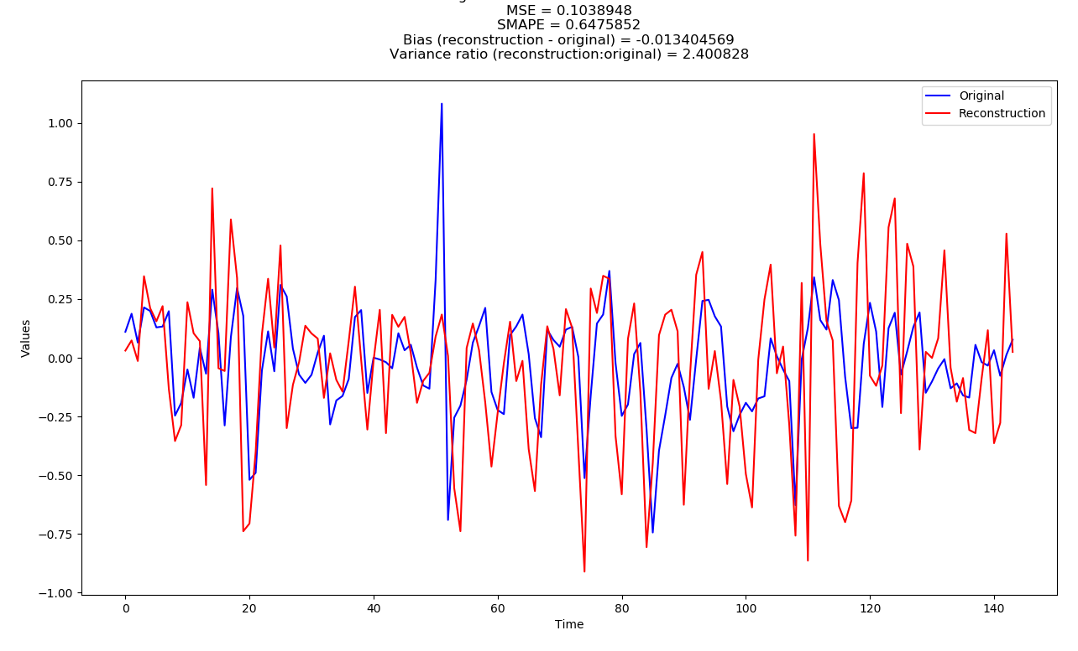
Model and results

Slide 42
Model and results

Slide 43
Model and results
So there are two things everyone expects from Auto-encoders:
Encoded latent vector projections – Not so good
Reconstruction errors – Pretty good

Slide 44
Model and results
Now we just need to classify these reconstruction errors somehow
Look at reconstruction error distribution
Decide a threshold to balance FPs/FNs

Slide 45
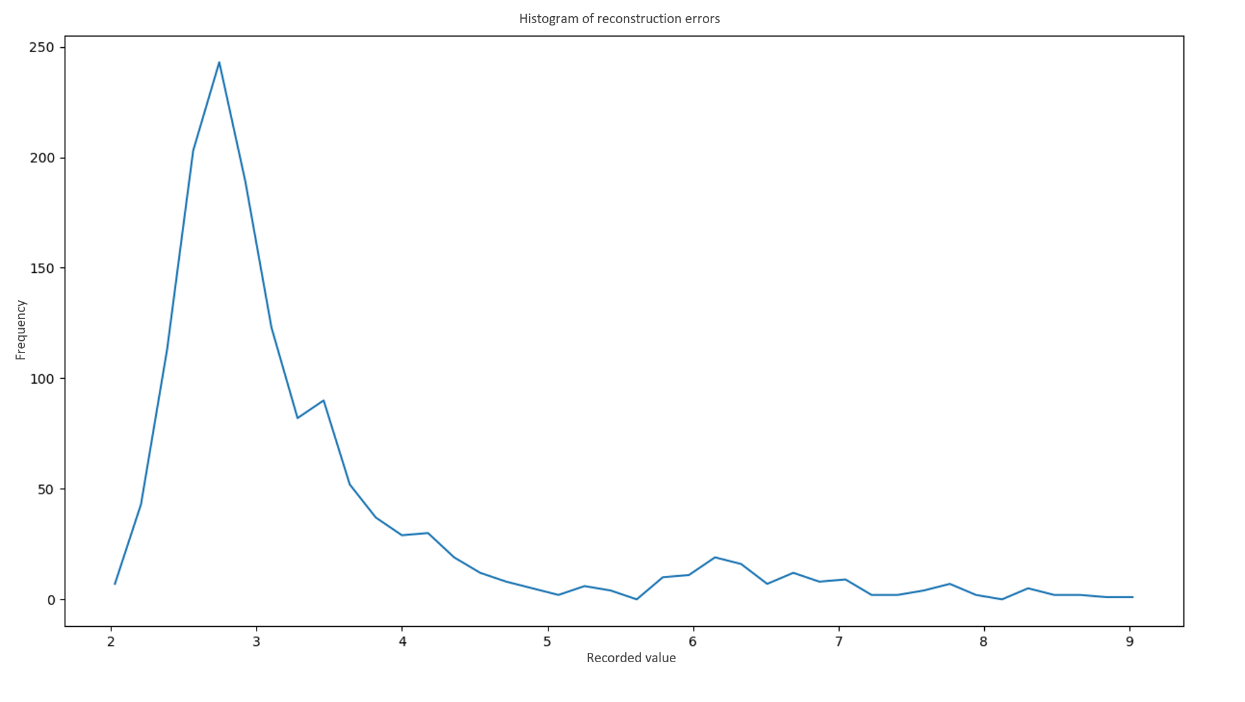
Model and results

Slide 46
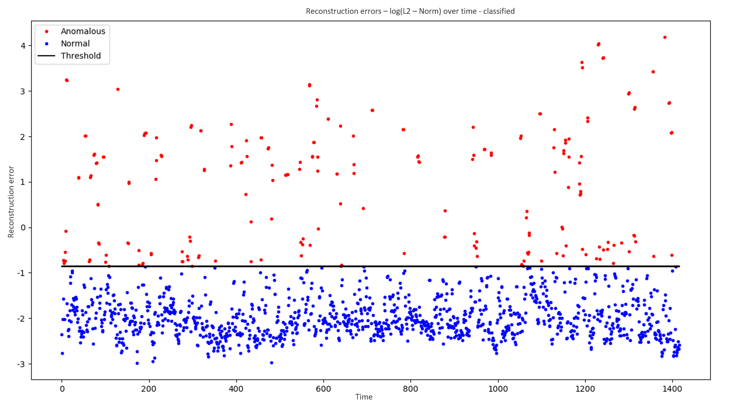
Model and results

Slide 47
Model and results

Slide 48
Model and results

Slide 49
Model and results
Predicted Actual | True | False | Total
True | 1203 | 205 | 1408
False | 1 | 8 | 9
Total | 1204 | 213 | 1417

Slide 50
Further work
Better data-preprocessing
More experiments with latent space and projections
Sample variance weighted loss function – More inclusive reconstructions

Slide 51
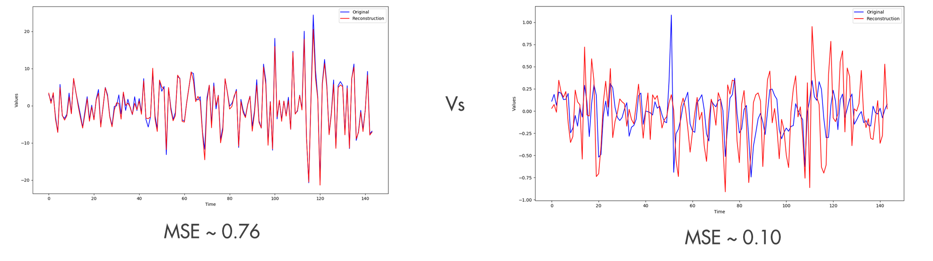
Further work
Recon errors (loss function) could be 400x larger
No incentive to optimise for most features
Result is based on a few features only

Slide 52
Further work
Better data-preprocessing
More experiments with latent space and projections
Sample variance weighted loss function – More inclusive reconstructions
Time-dependent classification boundary

Slide 53
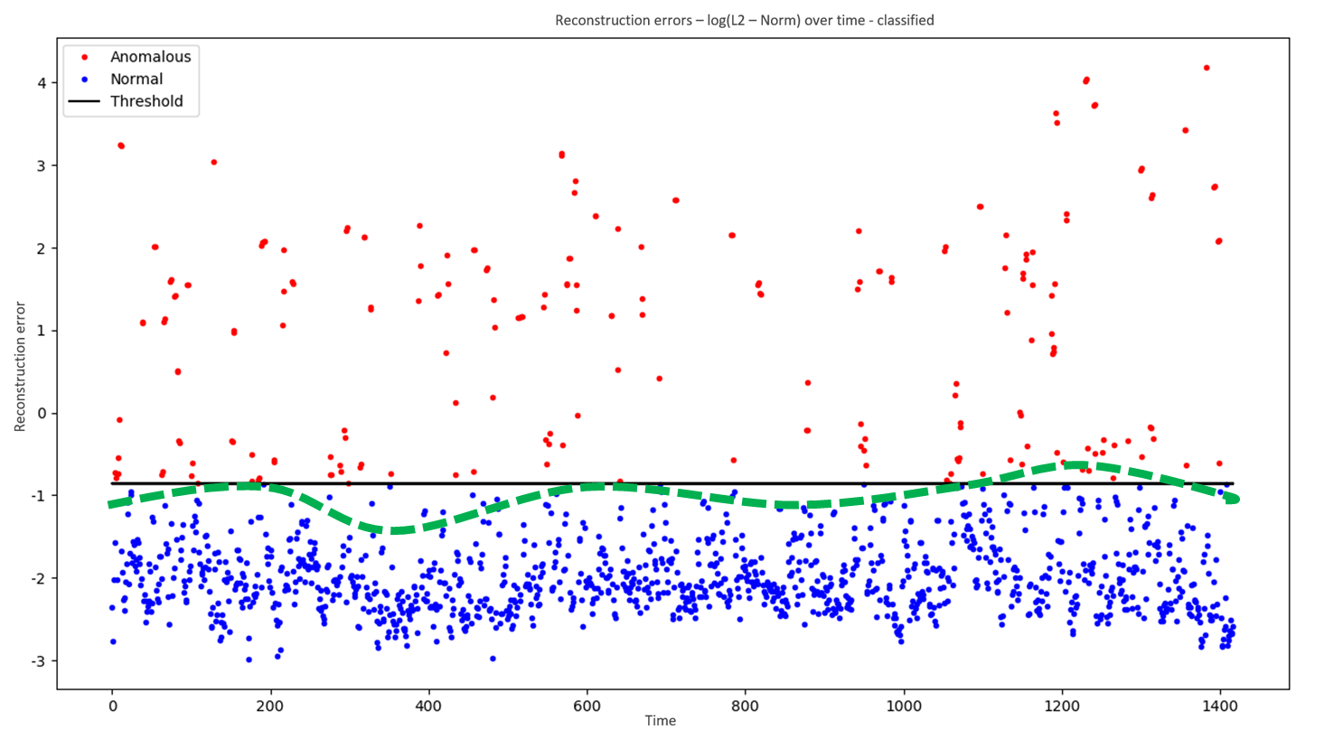
Further work

Slide 54
Further work
Better data-preprocessing
More experiments with latent space and projections
Feature variance weighted loss function – More inclusive reconstructions
Time-dependent classification boundary
Time-to-failure predictions based on reconstruction error time-series

Slide 55
Anomaly generation

Slide 56
Why do we need to generate data?
Why do we even need more data?
Unsupervised works and can be a lot better right?...

Slide 57
Why do we need to generate data?
But we can always use more data, especially anomalies
Perhaps we can get some success with supervised methods?
Reduce class imbalance
Train RNN-based direct classification models
Perhaps even direct time-to-failure models?...

Slide 58
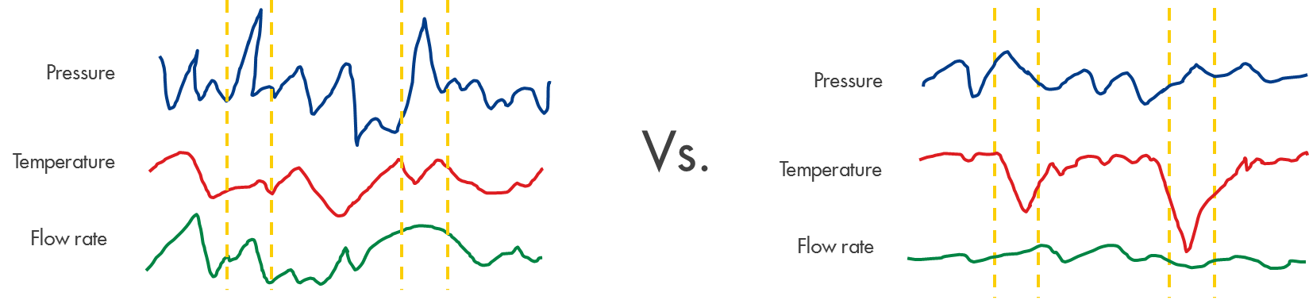
Why do we need to generate data?
...and would like to learn more about various types of anomalies…

Slide 59
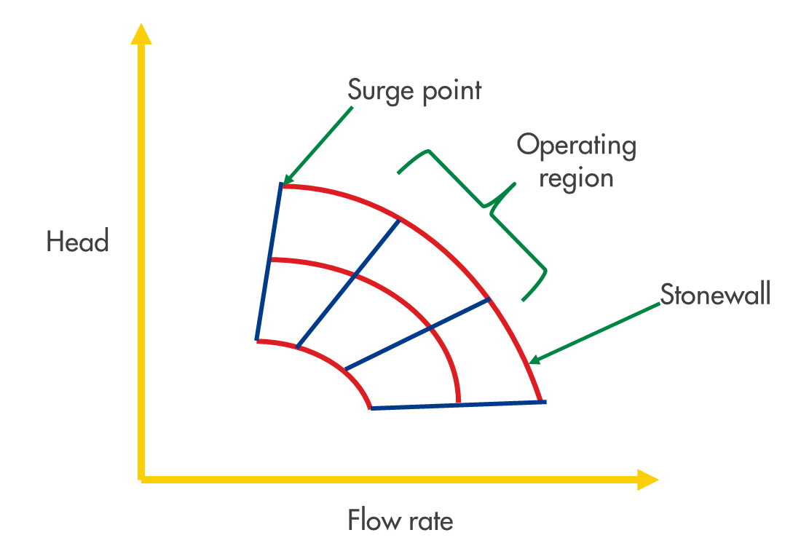

Why do we need to generate data?
…as well as new anomalies that are very rare or impossible.

Slide 60
Considerations
We have a 3 step plan:
We have to be able to sample from the real data distribution
We need to post process a string of random samples into a realistic time-series
We need to figure out how to make “anomalous-looking” time-series
?
?
?

Slide 61
Considerations
Step 1: Lets see the distribution first

Slide 62
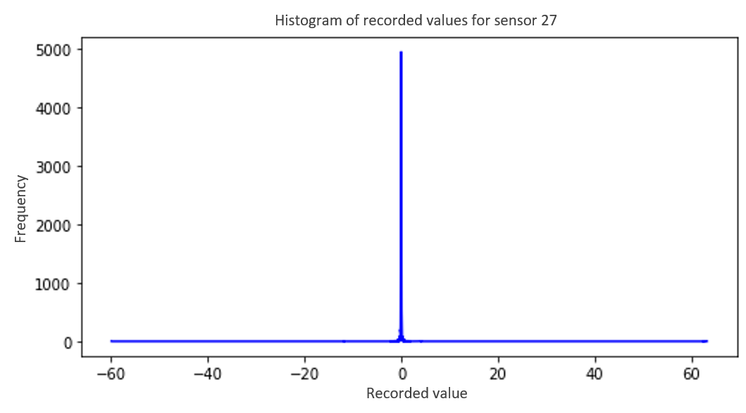
Considerations
98% of all data
1%
1%

Slide 63
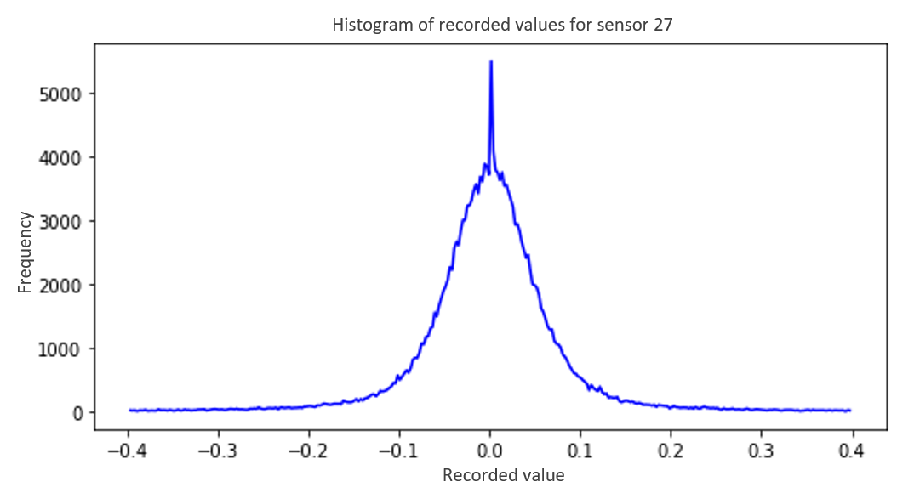
Considerations

Slide 64
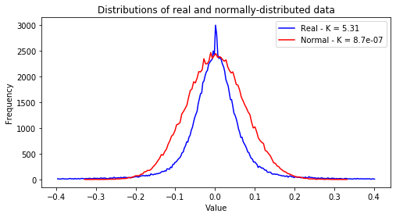
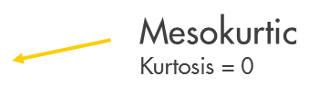
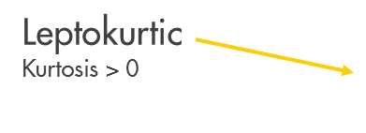
Considerations

Slide 65
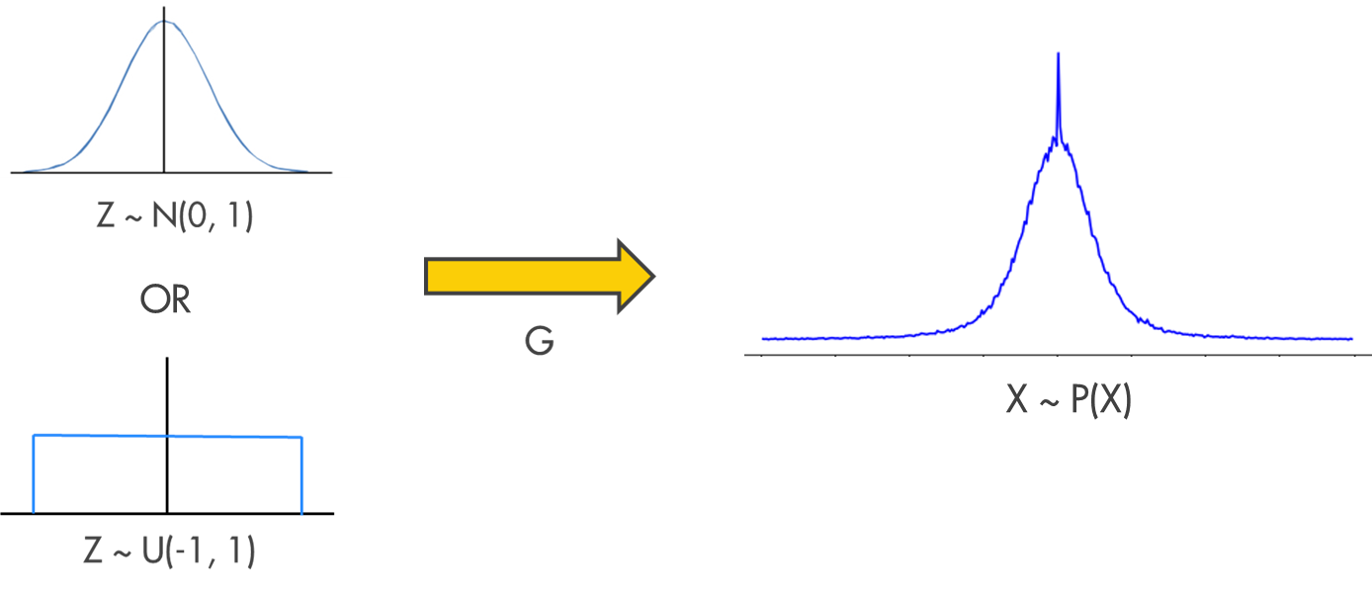
Considerations
- Essentially we want to create some mapping from samples from one distribution to another:

Slide 66
Model and results
We tried some simple ideas…
Approximate the inverse CDF of the data
Kernel density estimation with bootstrapping
ML/Bayesian methods
But these require certain conditions/assumptions, and hard to scale

Slide 67
Model and results
…But in the end we chose to go with
Generative adversarial networks (GANs)

Slide 68
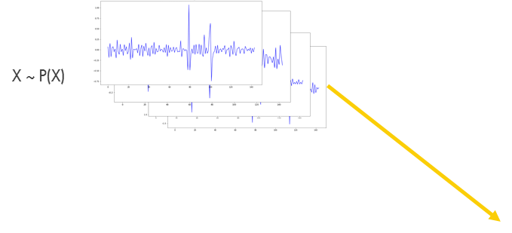

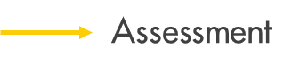

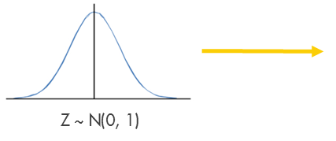
Model and results

Slide 69
Model and results
Some that we implemented:
GAN
LSGAN
WGAN
WGAN + GP

Slide 70
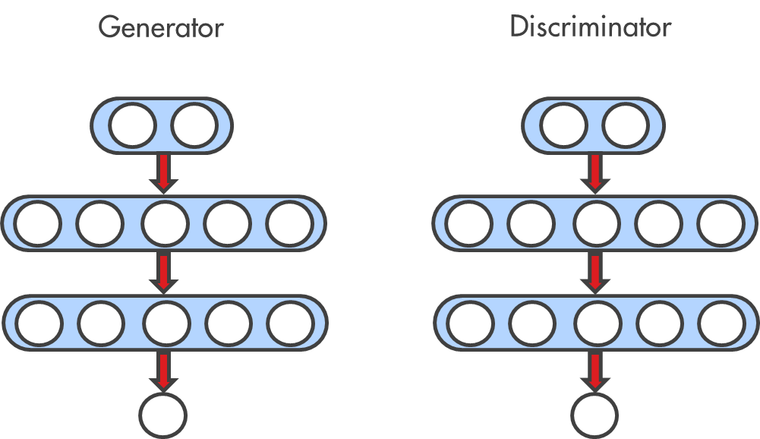
Model and results
We tested a few architectures:
- MLP

Slide 71
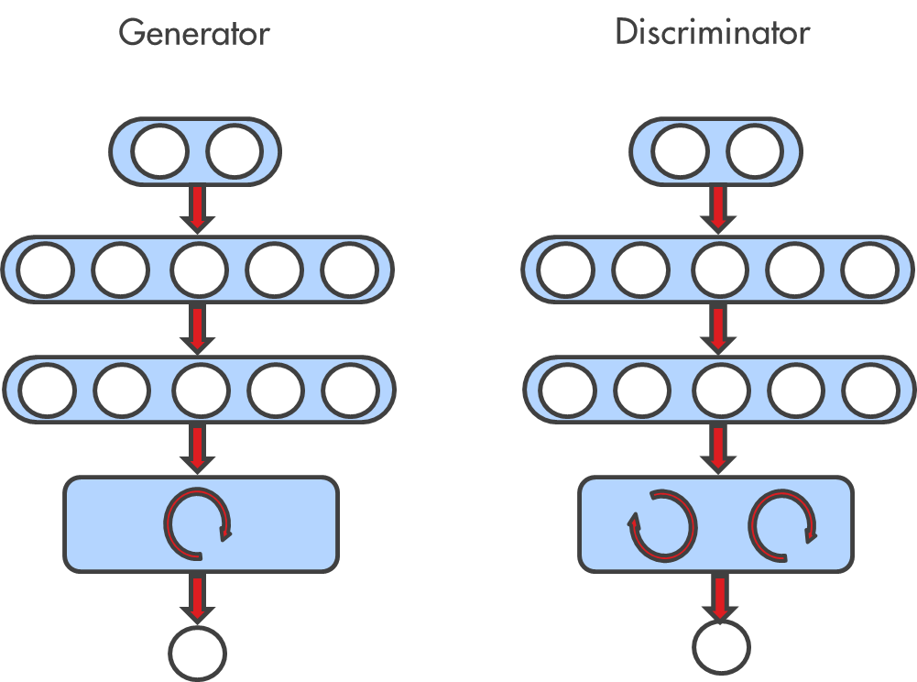
Model and results
We tested a few architectures:
- MLP
RNN

Slide 72
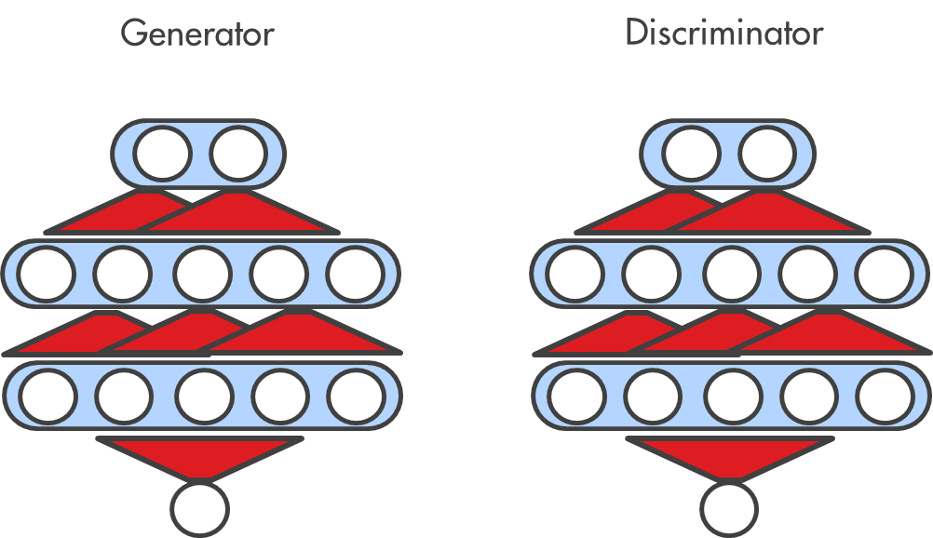
Model and results
We tested a few architectures:
- MLP
RNN
Temporal convolutions

Slide 73
Model and results
Some just didn’t work no matter what was tried:
- MLP - Some success
RNN - Some success
Temporal convolutions – No success

Slide 74
Model and results
Details:
Multi-layer perceptron (4 linear layers) with LeakyReLU non-linearity
Learning independent, One-dimensional distribution of each feature separately
Latent space larger than output space (Generator)
Discriminator has around 100x capacity of generator
No Recurrent layers – Optimisation and loss has nothing to do with temporal dependencies
Keep step 1 as pure as possible – distribution only

Slide 75
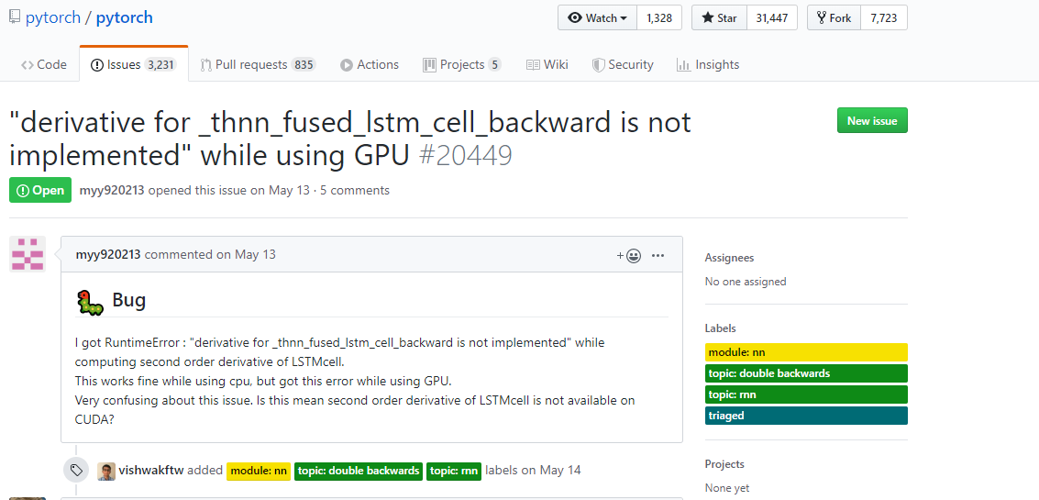
Model and results

Slide 76
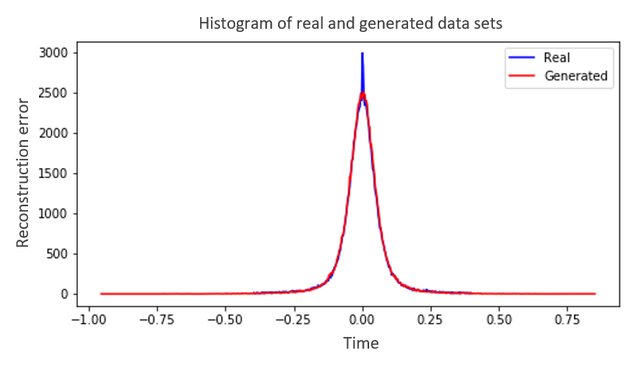
Model and results
After a lot of experiments, went with LSGAN
And got good results!

Slide 77
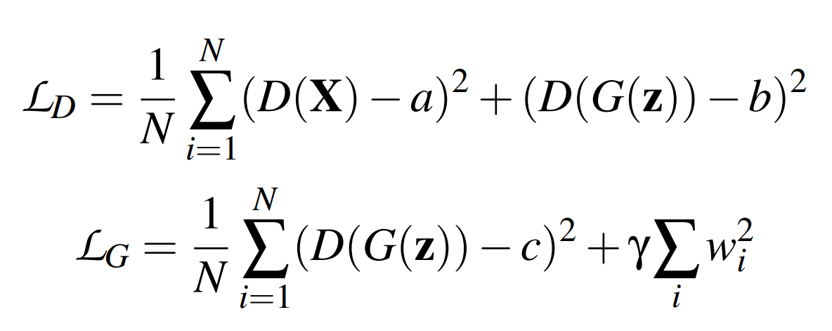
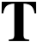
Model and results
After a lot of experiments, went with LSGAN
And got good results!

Slide 78
Model and results
A = C = 1
B = 0
Gamma = 0.01

Slide 79
Model and results
Applied weight decay to generator:
Much more stable and smooth convergence

Slide 80
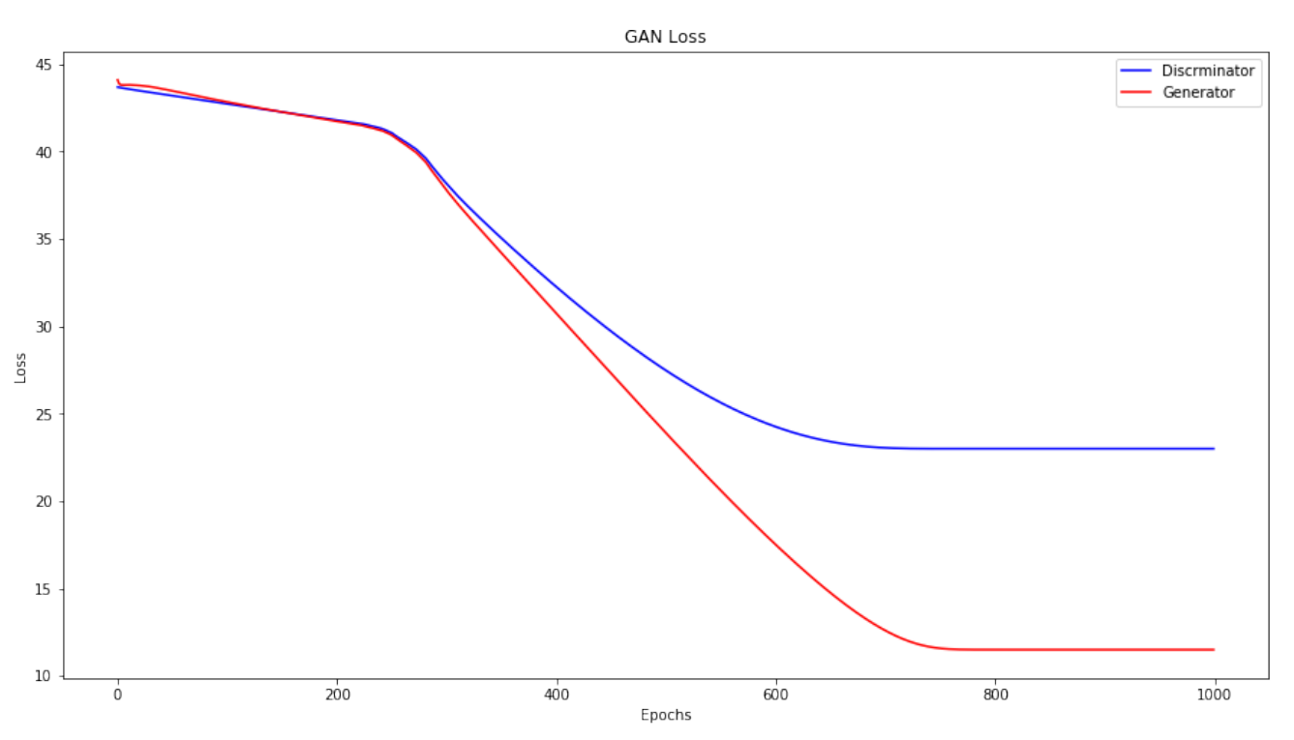
Model and results

Slide 81
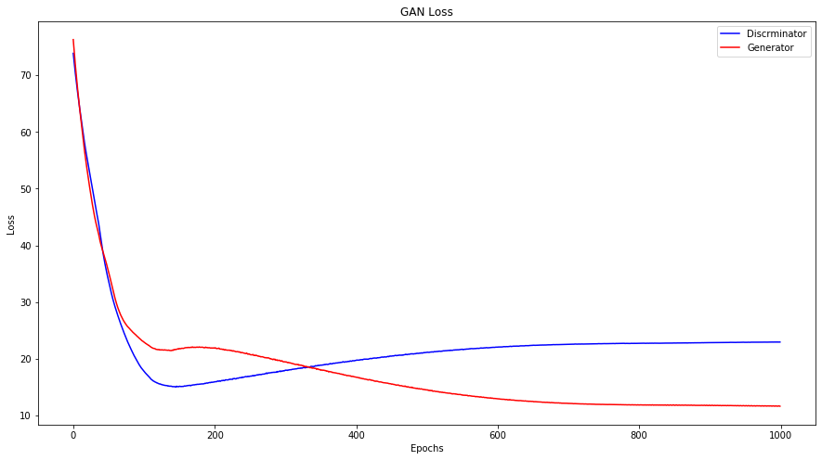
Model and results

Slide 82
Model and results
Applied weight decay to generator:
Much more stable and smooth convergence
Very reliable convergence

Slide 83
Model and results
Models Results | GAN | LSGAN | WGAN | WGAN + GP
JS-divergence | 0.089 | 0.0034 | 0.014 | 0.013
W-distance | 197.01 | 15.40 | 80.92 | 46.57

Slide 84
Further work
So far we’ve only accomplished step 1…
We have to be able to sample from the real data distribution
- Extend to multivariate distributions
We need to post process a string of random samples into a realistic time-series
We need to figure out how to make “anomalous-looking” time-series
But time was nearly up, so we had to git going

Slide 85
Further work
But we have some plans:
PLAN 1:
Merge steps 1 and 2:
Dual/Multi discriminator GANs
Multi-objective recurrent GANs
What is a “real” time-series?

Slide 86
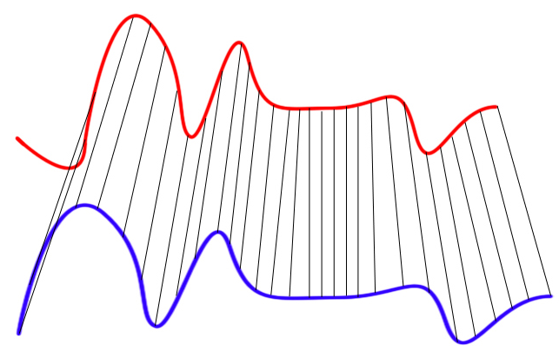
Further work
Dynamic time warping (DTW)
Similarity measure between time series
No strong assumptions about the data (scale invariant)
SoftDTW – differentiable implementation

Slide 87
Further work
But we have some plans:
PLAN 1:
Merge steps 1 and 2:
Dual/Multi discriminator GANs
Multi-objective recurrent GANs
Step 3:
Randomly adding short-term large scale noise?
LSTM post-processor
What is a “real” time-series?

Slide 88
Further work
But we have some plans:
PLAN 2:
Step 1 remains same
Merge steps 2 and 3:
De-noising auto-encoders
Style transfer models

Slide 89
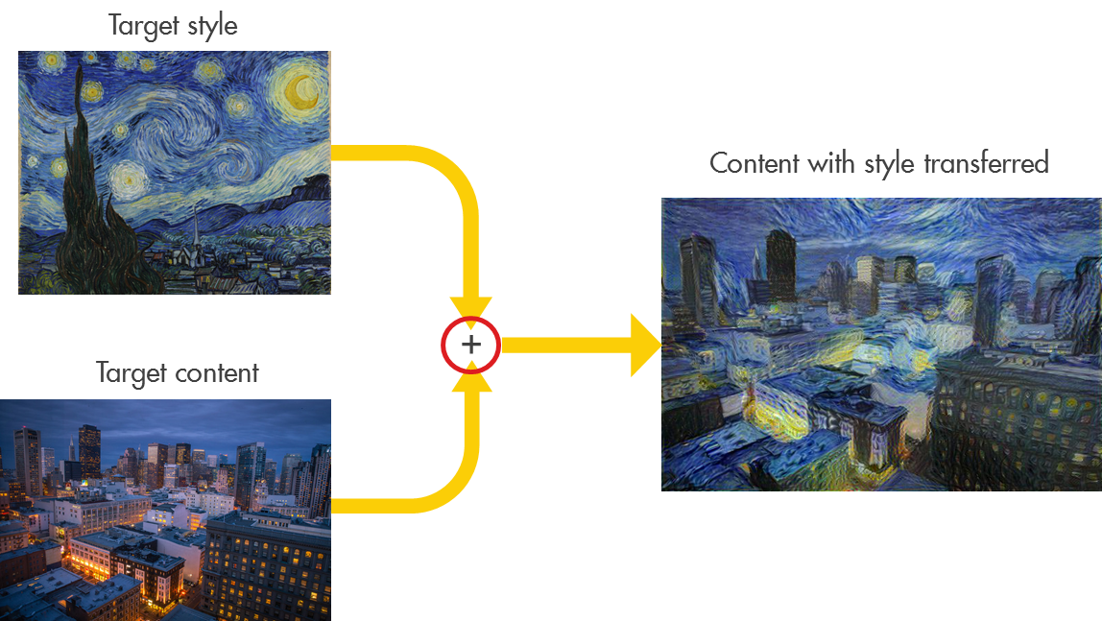
Further work
Style transfer models

Slide 90
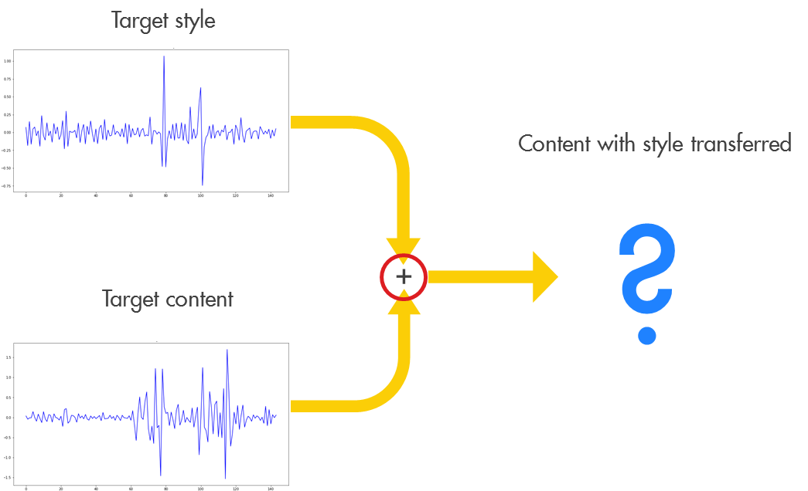
Further work
Style transfer models

Slide 91
Summary
Compressors are crazy
Real data is very messy – still not done cleaning
Anomaly detection shows some good first results – can be much improved
Anomaly generation has just started, and needs a lot more research
So much more can be done…

